Slide 1
The Planes and Passengers of 9/11: Where did they go?
By Dean T. Hartwell, J.D.
Notes:
Notes
Dean Hartwell has specialized in the research of planes and passengers of 9/11
These are his most up-to-date ideas and follows his books on the topic, Dead Men Talking and Planes without Passengers

Slide 2
“The truth is rarely pure and never simple.” -Oscar Wilde
Notes:
The official theory is certainly simple
Go over the theory briefly to set up a comparison with it and with my alternative
This theory is a lot like Oswald supposedly leaving evidence behind, then getting killed
No one can verify OBL, Al-Qaeda, hijackings, phone calls, etc.

Slide 3
BTS + ACARS = My Alternative Story
No Hijackers
Fake Phone Calls
No Real Passengers
No American 11 or 77
Notes:
Bureau of Transportation Statistics says only 93 and 175 flew
Aircraft Communications Addressing and Reporting System says 93 flew near Champaign, IL after its “crash” in Shanksville, PA and that 175 flew near Pittsburgh, PA after its crash at World Trade Center in New York

Slide 4
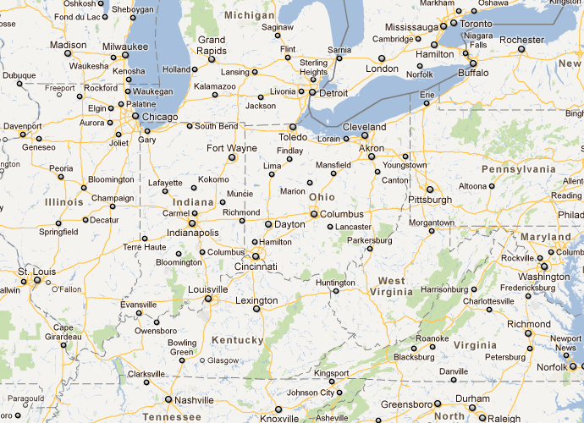
“The Truth is 542 Miles Away”
Notes:
ACARS has United 93 hundreds of miles away from where it supposedly crashed!
Question is not about any crash but about where 93 and 175 landed!
Map also shows the approximate distance of 93 from 175 via ACARS (although times were different)

Slide 5
Pictures Tell the Story
Notes:
Difficult to verify that any of these “passengers” existed as these identities

Slide 6
Cleveland
Notes:
Best possibility for landing of 175. This flight had time to fly into Cleveland by 10:40 AM, when a mystery plane is reported as having landed there.

Slide 7
Barbara Olsen
Notes:
Best known person on any of the “flights.” But her flight, 77, never even took off! How to explain those alleged phone calls to husband Ted?

Slide 8
The Mark Bingham Call
A caller claiming to be passenger Mark Bingham said:
Caller: “Mom? This is Mark Bingham. I want you to know that I love you. I’m on a flight from Newark to San Francisco and there are three guys who have taken over the plane and they say they have a bomb.”
Alice: “Who are these guys?
Caller: (after a pause) “You believe me, don’t you?
Alice: “Yes, Mark. I believe you. But who are these guys?
Notes:
Most recountings of “calls” from planes were from FBI reports of “relative” interviews. Looks more like poor script writing.

Slide 9
“If the facts don't fit the theory, change the facts.”
-Albert Einstein

Slide 10
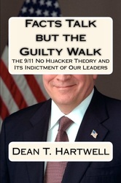
Hartwell Perspective Truth & Relevance
www.DeanHartwell.com

